Slide 1

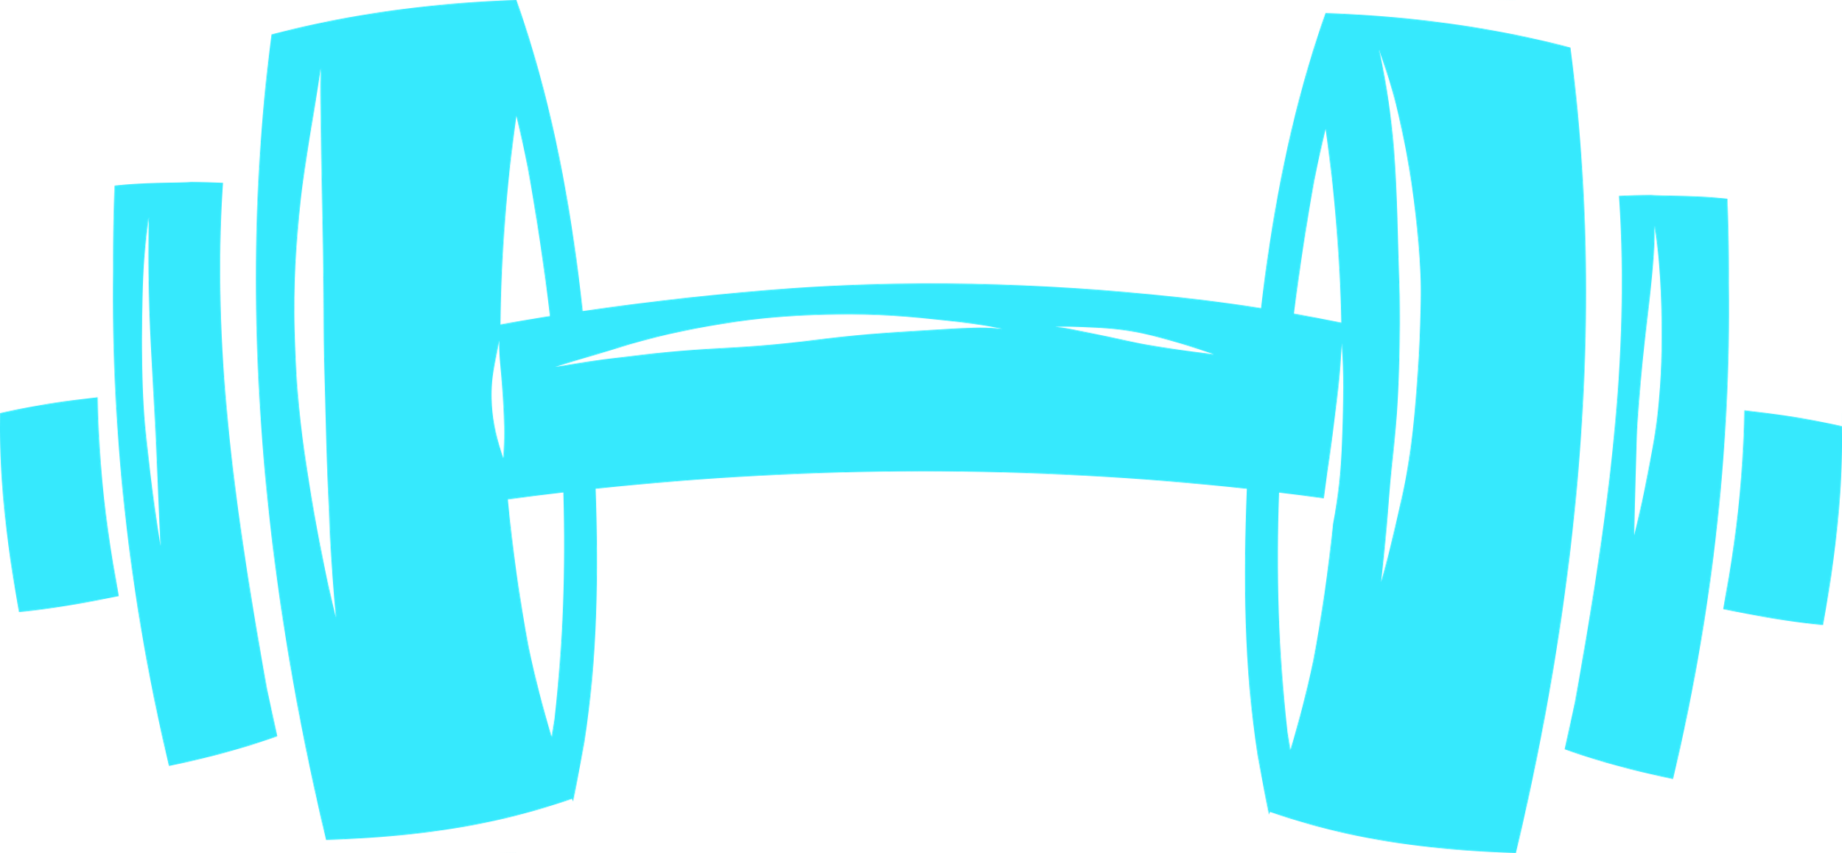
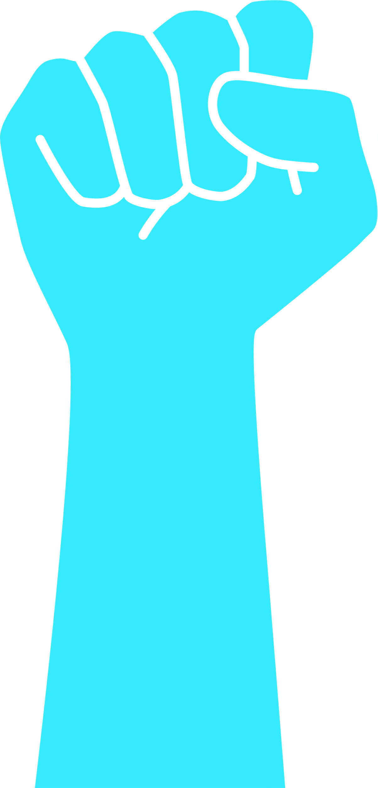

BodyTrack
Real-Time Posture Evaluation Using Biomechanics & Machine Learning
Final Project ID: 25-2-D-4
Presented by: Elad Krauz & Uri Ziv
Supervisors: Elena Kramer and Dr. Dan Lamberg
Department of Software Engineering, Braude College of Engineering
Notes:
Good [morning/afternoon], everyone.
We’re Elad Krauz and Uri Ziv, fourth-year students in Software Engineering at Braude College. Today, we’re excited to present our final project – BodyTrack – an Android-based application that provides real-time posture feedback during strength training, using only a smartphone.
This project brings together several powerful technologies: computer vision, biomechanics, and machine learning – to help people train more safely and effectively.
The idea started from a simple yet important observation: many people work out alone, without professional guidance. Incorrect posture can lead to serious injuries over time, and today’s apps don’t solve this problem.
With BodyTrack, we aimed to create a practical, lightweight, and intelligent system that supports users during workouts — just like a virtual personal coach — by detecting incorrect posture and giving live corrective feedback.
We’ll walk you through the problem, our solution, the system design, algorithms, and testing — and show how everything connects to create a complete real-world product.
Let’s begin with the problem we’re trying to solve.

Slide 2
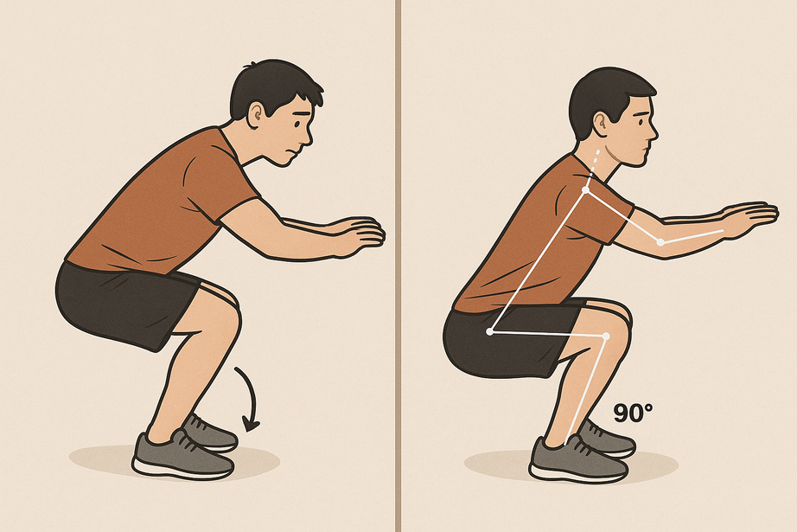


The Problem: Unsafe Training Without Supervision
Strength training is more popular than ever. But while access to equipment has grown, access to expert supervision hasn’t.
Most people train alone, without knowing if their posture is right - and mistakes go unnoticed.
Incorrect posture during exercises can lead to:
Muscle imbalances that affect progress
Joint stress and long-term injuries
Ineffective workouts with little improvement
Current fitness apps do not offer real-time posture correction.
Most users only realize their mistakes when it’s too late - after pain or injury occurs.
Notes:
Let’s talk about the core problem that led to the idea behind BodyTrack.
Strength training has become part of everyday life for many people. Gyms are full, and fitness is trending — but coaching and supervision haven’t kept up. Most people simply train on their own, using YouTube videos or generic workout apps.
The risk here is that posture and movement technique are often incorrect — and users don't even realize it. Over time, that leads to injuries, muscle imbalances, and frustration from poor progress.
We spoke with gym members who confirmed this: many had experienced pain or discomfort after training, but didn’t know what they were doing wrong.
And while apps exist to help with workouts, they don’t actually analyze your body. They might count reps or suggest routines — but they won’t stop you mid-set and say:
“Hey, your back is rounding. Straighten up.”
That’s the gap. And that’s where we saw an opportunity to create something much smarter, more responsive, and more helpful — which we’ll explore in the next slides.

Slide 3
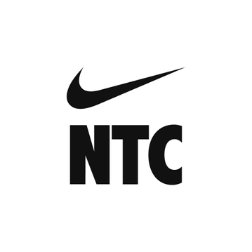

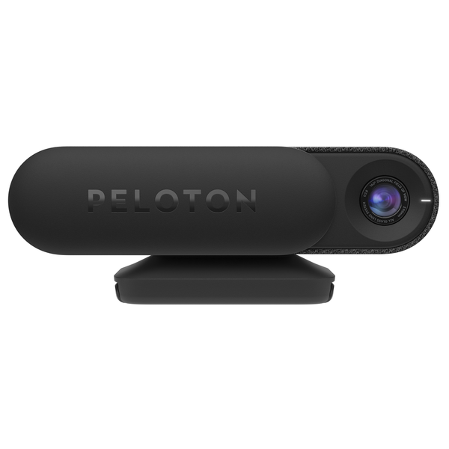
What Exists Today – and Why It’s Not Enough
There are many fitness apps and smart devices on the market today. None of them provide real-time posture correction using only a smartphone.
Existing solutions include:
Training apps like Nike Training Club or Freeletics – offer workouts, but no form tracking
Devices like Mirror or Peloton Guide – provide camera-based feedback, but are expensive and require special hardware
Apps like Kaia Health – focus on therapy, not full-body strength exercises
These tools are useful, but they don’t solve the core problem: helping people correct form in real time, during strength exercises, without buying new equipment.
Notes:
Before we show you what we built, let’s take a look at what already exists.
There are lots of apps and tools in the fitness space. You’ve probably heard of Nike Training Club, Freeletics, or workout videos on YouTube. These help you stay active — but they don’t watch your posture. They’re just timers with exercises.
Then we have devices like Mirror or Peloton Guide, which do use cameras — but they come with a high price tag and require buying specialized equipment. They’re also limited in how much real biomechanical feedback they offer. It’s more about matching movements to a coach visually — not analyzing your joint angles or telling you when your knees are collapsing inward during a squat.
There are also clinical apps like Kaia Health, which focus on rehabilitation and limited movements. These aren't really designed for general gym training or strength exercises.
So overall, the fitness tech market is either too basic — or too expensive and restrictive.
We saw a gap: what if users could get real-time posture analysis, for strength training, just using their phone?
No sensors. No wearables. No mirror on the wall.
Just your phone, your camera, and smart feedback.
This is exactly what we designed BodyTrack to deliver.

Slide 4
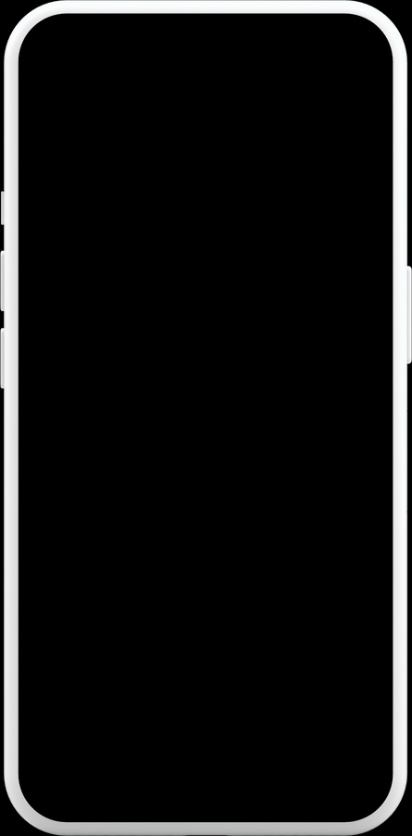
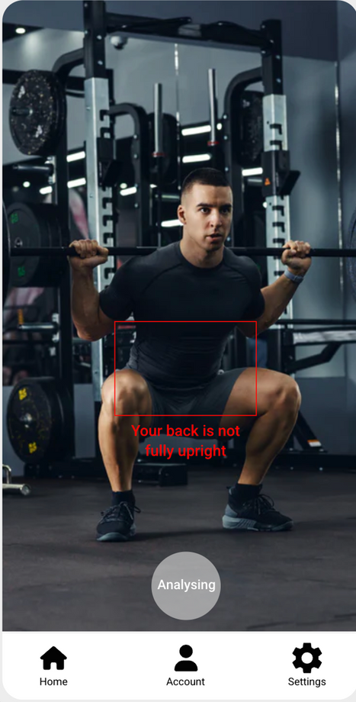
Our Goal:
Real-Time Posture Correction for Everyone
BodyTrack is an Android-based app that helps users improve their exercise technique — safely, effectively, and independently.
Our mission:
Use only the smartphone’s camera — no external hardware needed
Make smart coaching accessible to anyone, anywhere
Deliver real-time feedback on posture and joint alignment
We aim to reduce injuries, improve performance, and help users train confidently — just like having a personal coach in your pocket.
Notes:
So, what is our vision?
We wanted to create a tool that truly helps people correct their posture while they train — not afterward, not passively, but in real time.
With BodyTrack, our goal was clear:
Give gym-goers — especially those who train alone — a smart, accessible assistant that can help them perform exercises safely and properly, without needing a trainer or expensive devices.
The app uses the phone's camera to track your body, analyze your movement, and detect mistakes — all while you're exercising.
You don’t need sensors.
You don’t need to wear a smartwatch.
You don’t need to buy any smart mirror or AI gym equipment.
All you need is your phone.
And in return, you get instant guidance — for example:
“Go deeper in your squat.”
“Don’t let your knees collapse.”
“Keep your back straight.”
Our goal was to bring professional-level feedback to regular people, and help them train better, safer, and more confidently.
In the next slide, we’ll show what BodyTrack actually looks like and how the system is built.

Slide 5
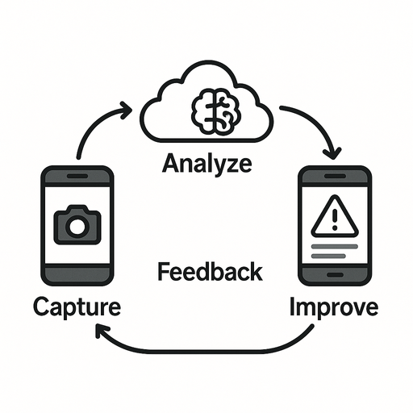

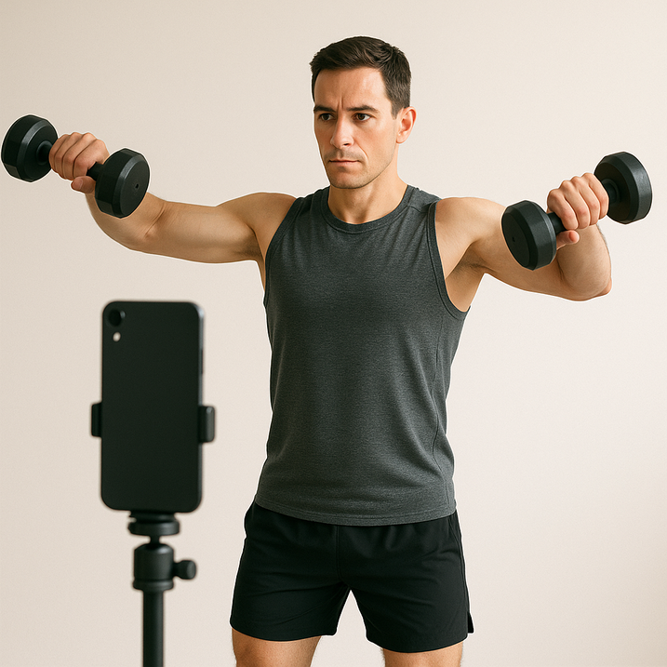
How BodyTrack Works – The Concept
BodyTrack is a real-time posture analysis system built as a mobile–cloud solution.
Here’s what it does:
1
Captures live video from the phone’s camera
2
Sends frames to a remote server for processing
3
Server runs pose estimation and biomechanical analysis
4
If an error is found, the app gives instant feedback — visually and through audio
5
At the end, a summary report helps the user improve over time
The app acts as a virtual personal coach, guiding the user during strength exercises like squats, curls, and shoulder raises.
Notes:
Let’s break down how BodyTrack actually works.
When a user opens the app and selects an exercise — for example, squats — they place their phone at a distance so the camera sees their full body.
As they begin the workout, the phone continuously captures frames from the camera and sends them, in real time, to a remote server we built.
The server uses pose estimation models to detect key body joints and then applies our biomechanical logic to measure joint angles, movement phases, and form accuracy.
If something looks wrong — like the squat is too shallow, or the knees are misaligned — the app immediately alerts the user.
That alert might be a text popup, a highlight on the body, or an audio instruction, like:
“Go deeper” or “Straighten your back.”
At the end of the session, the app shows a summary report:
How many reps were correct
What common mistakes were found
Suggestions for improvement
This entire process happens in real time, and the user doesn’t need to do anything except train normally — the app handles the rest.
In the next slide, we’ll zoom out and look at the system architecture that makes this possible.

Slide 6
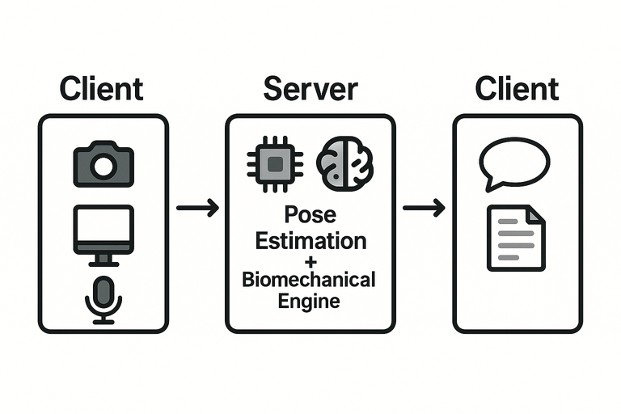
System Architecture:
Lightweight Client, Smart Server
BodyTrack is built as a modular client–server system:
The mobile app (client) handles the camera, UI, and displaying feedback
The server (backend) handles all pose analysis and biomechanical evaluation
This design keeps the app fast and responsive, while the server performs the heavy computation.
Architecture layers:
Input Layer (Client): captures video frames
Analysis Layer (Server): pose detection, angle analysis, error detection
Presentation Layer (Client): displays feedback and session summary
This separation ensures real-time feedback and easy future updates.
Notes:
Here’s how BodyTrack is structured behind the scenes.
We use a client–server architecture, which means the mobile app (the client) and the server (the backend) each handle different responsibilities.
The mobile app is intentionally lightweight. It’s responsible for:
Capturing video through the camera
Sending frames to the server
Receiving and displaying feedback
Providing a clean, intuitive user experience
The backend server, on the other hand, does all the heavy lifting. It runs:
The pose estimation model
Biomechanical analysis, where we compute joint angles and identify movement phases
The error detection logic, which checks if the movement violates any rules (e.g., shallow squat, poor alignment)
This structure helps us achieve two key things:
Performance – the app stays smooth even on mid-range phones
Flexibility – we can update models and logic on the server without needing to update the app
This separation of roles also makes our system more scalable. If we want to support more exercises in the future, we just add them to the server logic — the app remains the same.
In the next slide, we’ll walk through the actual data flow — what happens, step-by-step, from the moment the user hits "Start".

Slide 7
How Data Moves: From Camera to Correction
User starts session and selects an exercise
The camera captures frames of the user during movement
The server performs pose estimation to detect joints
Frames are sent to the cloud server
After the session, a summary report is generated
If errors are found, feedback is sent back immediately
Posture is compared to biomechanical reference models
Joint angles and movement phases are calculated
This flow happens continuously during training — allowing live corrections.
Notes:
Let’s now walk through what actually happens when a user uses BodyTrack.
The user opens the app, chooses an exercise — say, a squat — and the app activates the camera.
As they begin moving, the app captures live video frames, which are immediately sent to our backend server.
On the server, the pose estimation model analyzes each frame to detect 33 body joints. Once the landmarks are identified, we calculate joint angles — like knees, hips, elbows — and detect which phase of the exercise the user is in (e.g., descent, bottom, ascent).
The server then compares these angles to a biomechanical model for that exercise. If something doesn’t match the correct range — for example, a knee isn’t bending far enough — the server flags it as an error and sends a message back to the mobile app.
The app responds immediately — with a visual cue, a highlight on the skeleton, or an audio alert, like:
“Go deeper”
“Straighten your back”
This loop runs continuously during the workout, frame by frame, enabling users to correct mistakes in real time.
At the end of the session, the server sends a summary report:
How many reps were completed
Which were correct or incorrect
What common mistakes were found
And how to improve
All of this is done in real time, creating an experience that feels responsive and helpful, like training with a coach — but using only your phone.
Next, we’ll zoom into the first major step in this pipeline: pose estimation.

Slide 8
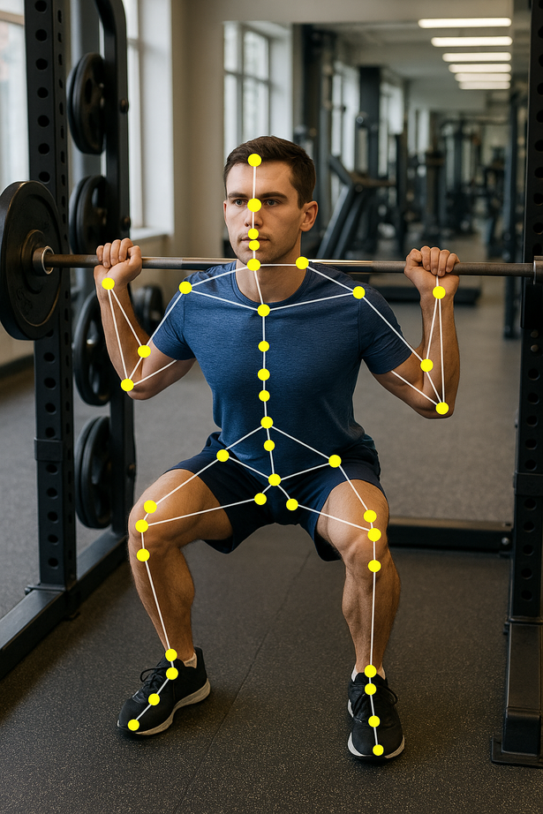
Pose Estimation – Powered by MediaPipe
BodyTrack uses MediaPipe Pose, a real-time pose estimation framework developed by Google.
Detects 33 body landmarks (e.g., shoulders, elbows, hips, knees, ankles)
Uses a two-stage pipeline:
→ First, detects the person’s region of interest
→ Then uses a CNN-based regression model to estimate
joint coordinates
Outputs (x, y) position + visibility confidence per joint
Provides smooth, stable tracking using built-in filtering
Runs in the Python backend, enabilng efficient cloud-based processing
Supports both 2D and approximate 3D (Z-Axis) tracking
This pose data is the foundation for calculating angles and detecting posture errors in real time.
Notes:
To analyze how a user is moving, we first need to know where their joints are — frame by frame. For this, we use MediaPipe Pose, a lightweight yet powerful pose estimation tool developed by Google.
MediaPipe works in two stages:
A detector finds the full-body region of interest from the video frame.
Then, a regression-based CNN (Convolutional Neural Network) is applied to estimate the exact (x, y) coordinates of 33 joints, such as the shoulders, elbows, hips, knees, and ankles.
This method is different from some other frameworks that rely on heatmaps. MediaPipe directly predicts joint positions, making it faster and more efficient — which is crucial for real-time use.
Each joint also comes with a visibility score, which tells us how confident the model is in that point — helpful for ignoring noisy or occluded detections.
What makes MediaPipe ideal for BodyTrack is not just its speed, but its stability over time. It includes built-in smoothing filters, which reduce flicker and keep the skeleton stable even during fast movement.
We’ve integrated MediaPipe into our Python backend, which means the processing is handled on the server — allowing the mobile app to stay lightweight. It even supports approximate 3D estimation, using only a standard camera.
The output of MediaPipe is what feeds directly into our biomechanical analysis engine, which takes those coordinates and calculates joint angles, identifies movement phases, and checks for postural errors.

Slide 9
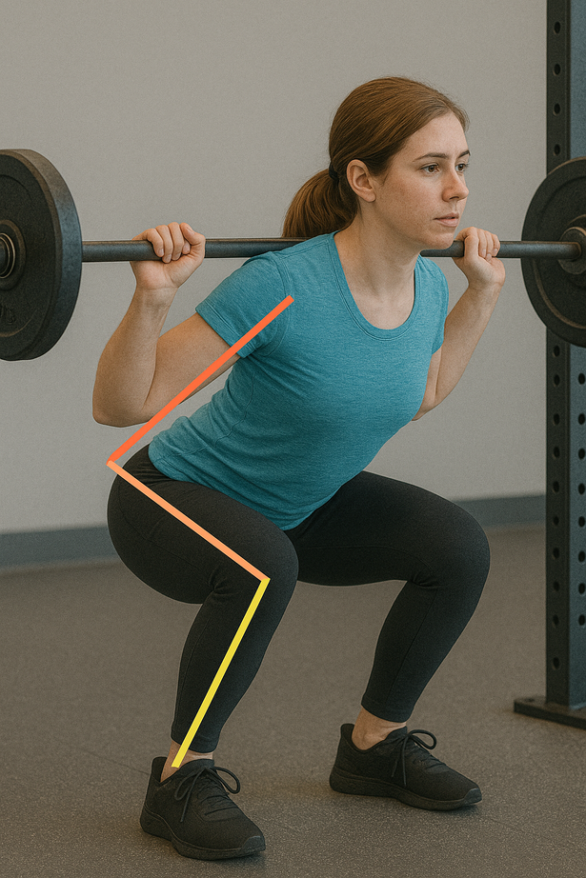

Understanding Movement – Joint Angles and Biomechanical Rules
After pose estimation, BodyTrack performs biomechanical analysis to evaluate form.
Calculates joint angles using vector geometry (e.g., knee, elbow, back)
Detects movement phases (e.g., descent, bottom, ascent)
Compares posture to exercise-specific reference models
Implemented using NumPy and vector math in the Python backend
Includes tolerance thresholds to allow small natural variations
For example: In a squat, BodyTrack checks that
→ Knee flexion reaches at least 100°
→ Back tilt stays under 45°
→ Both knees move symmetrically (≤10° difference)
Notes:
Once we know where the joints are, we move on to the biomechanical analysis — this is where we evaluate how well the user is actually performing the exercise.
First, we calculate joint angles from the detected landmarks.
This is done using vector math — specifically, we measure the angle between vectors that connect joints. For example:
To calculate the knee angle, we use the points for hip, knee, and ankle
For the back angle, we use shoulder, hip, and vertical alignment
All of these calculations are done in Python using NumPy, which gives us fast and accurate results per frame.
Next, we use these angles to detect movement phases. For example, in a squat:
If the knee angle is decreasing, the user is going down
If it’s at the lowest point, that’s the bottom phase
If it’s increasing, they’re coming back up
But how do we know if they’re doing it correctly?
We built biomechanical reference models for each exercise, based on academic sources and professional coaching guidelines.
These models define the expected range of joint angles during correct form.
For example, in a squat:
Knee flexion must reach at least 100°
The back should not tilt more than 45°
The left and right knees should bend symmetrically (within 10°)
We also built in tolerance thresholds — because every person moves a bit differently. Our rules are not rigid, but flexible within healthy biomechanical ranges.
This entire analysis runs frame by frame, in real time, so we can detect posture faults as they happen.
In the next slide, we’ll explain how these angle checks turn into instant feedback for the user.

Slide 10

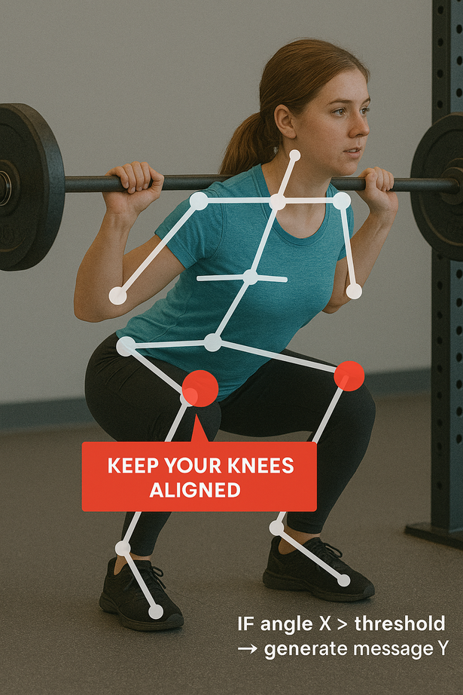
Detecting Posture Errors and Giving Real-Time Feedback
After analyzing joint angles and movement phases, BodyTrack uses defined biomechanical rules to detect mistakes.
Each exercise includes a set of error conditions (e.g., insufficient depth, asymmetry, unstable movement)
Errors are identified the moment they happen — frame by frame
These are implemented as decision trees that compare real-time values to thresholds
The system sends audio cues, visual overlays, or both, to correct the user instantly
Feedback is clear, timely, and designed to guide correction during the rep, not after.
Notes:
Once we’ve identified how the body is moving — and which phase of the exercise the user is in — we apply our biomechanical logic to determine whether the movement is correct or faulty.
This is where BodyTrack truly becomes a smart coaching system.
Each exercise — like squats, biceps curls, or lateral raises — comes with a set of common mistakes, based on known movement faults in biomechanics.
For example:
In squats, we check:
Did the knees bend enough?
Are both legs bending symmetrically?
Is the back posture safe?
In curls, we check:
Are the elbows staying in place?
Is the torso swinging to compensate?
We define these rules as if–else conditions — like:
“If knee angle is greater than 110° at the lowest point, then classify it as a shallow squat.”
These checks are implemented in the backend using Python-based decision logic, and evaluated in real time, frame by frame.
The moment a posture fault is detected, the server generates a message and sends it back to the app. Then the app provides:
Audio feedback using Android’s Text-to-Speech (TTS), like “Go deeper” or “Keep your back straight”
Visual feedback, such as red highlights on problematic joints
Optionally, pose overlays to show how the posture should look
What’s most important is when this feedback happens — not after the workout, but while the user is still doing the rep. This allows for correction in the moment, which is the best time to fix a mistake.
The feedback is designed to be clear, motivating, and non-intrusive. We don’t overwhelm the user with too many messages — only one prompt per issue at a time, based on priority and phase.
In short, BodyTrack provides just enough smart feedback to feel like a coach is standing beside you — correcting you only when it matters most.
Up next, we’ll show how all this is packaged into a simple and intuitive interface for users.

Slide 11
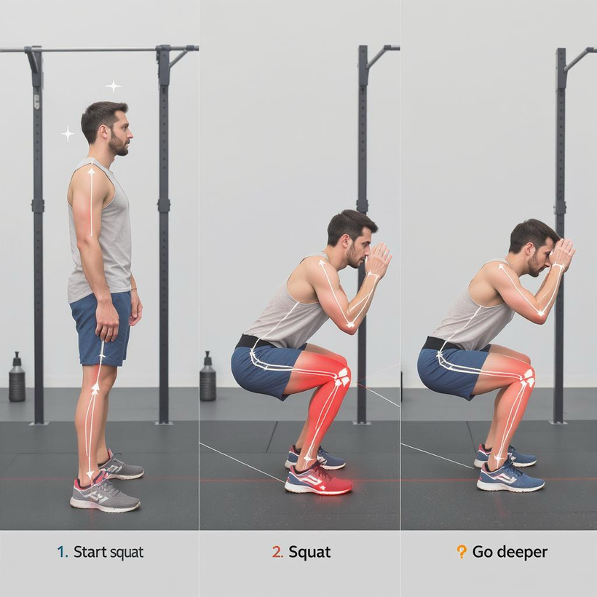
Case Study: How BodyTrack Evaluates a Squat
Let’s walk through how BodyTrack analyzes a squat — from joint tracking to feedback:
1. Phase Detection:
Descent phase: Hip and knee angles decrease smoothly
Bottom phase: Knee flexion reaches at least 100°
Ascent phase: Angles return to neutral (≈180°)
2. Joint Angle Rules:
Trunk tilt must stay under 45° from vertical
Symmetry: Left/right knees should be within 10°
Heel contact: Ankle angle must not exceed 100°
3. Real-Time Error Detection:
Shallow squat → “Go deeper”
Knee valgus (inward shift) → “Keep your knees aligned”
Trunk collapse → “Straighten your back”
Heel lift → “Keep your heels down”
All evaluations are performed frame by frame, using joint angles extracted from MediaPipe.
Notes:
Let’s now bring everything together with a real example: the squat.
Once BodyTrack receives the pose landmarks from MediaPipe, it begins analyzing the movement across time to determine the phases of the exercise:
In the descent, the knees and hips flex as the user lowers down.
In the bottom phase, the system checks if the knee angle reaches at least 100° — this is the reference point that tells us the user went deep enough.
During the ascent, the joint angles return to their starting (neutral) values.
At each point, we check for multiple biomechanical rules:
Trunk lean is calculated relative to vertical. If it exceeds 45°, that’s unsafe and flagged.
Symmetry is measured by comparing left and right knees and hips. If one side is 10° different, we alert the user.
Heel contact is evaluated by tracking ankle angle and vertical Y-position to detect if the heel lifts off the ground.
When an error is detected:
The system labels it in real time
Sends the proper audio cue (e.g., “Go deeper”)
And optionally displays a visual marker (e.g., red knees or curved trunk overlay)
This whole process happens live — every frame is analyzed instantly.
This slide represents exactly what we mean by automated coaching using biomechanics.

Slide 12
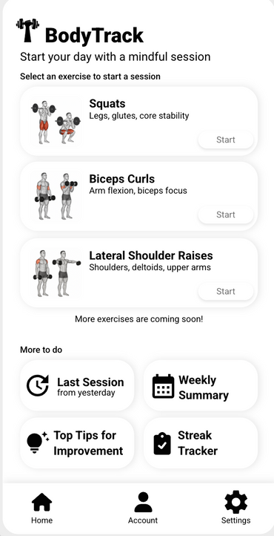
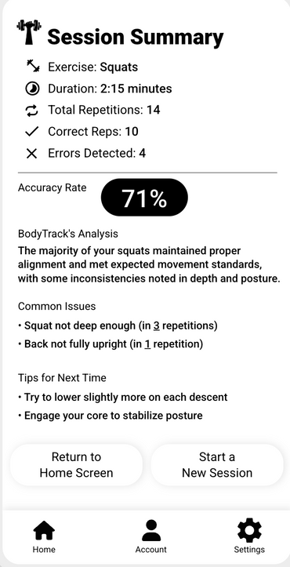
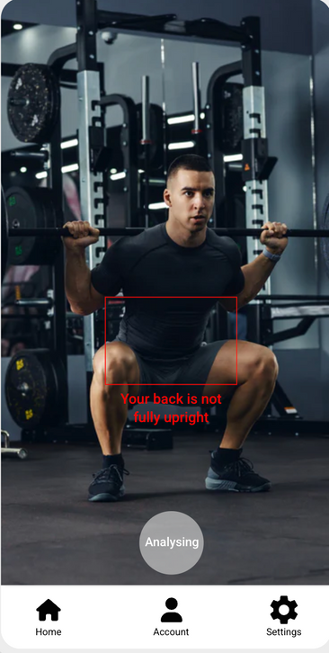
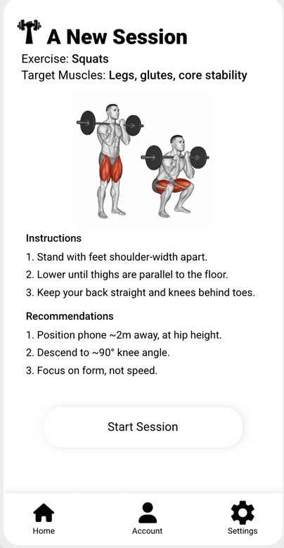
Designed for Clarity – The BodyTrack User Interface
BodyTrack was designed to feel like a real coach — without distractions
or complexity.
Minimal setup: Select exercise, position the phone, start training
Live visual overlays: Pose skeleton + joint highlights
Real-time cues: Audio alerts when posture errors are detected
Session summary: After each set – rep count, detected issues, improvement tips
The UI is developed in Kotlin, using Jetpack Compose and CameraX
for real-time camera integration.
Clear design = better focus, better training.
Notes:
Let’s now shift to the user experience.
Everything we've shown so far — pose estimation, biomechanical analysis, error detection — runs in the background.
But for the user, it all comes together through a simple, focused interface.
We built the BodyTrack app in Kotlin for Android, using:
Jetpack Compose for flexible, modern UI layouts
CameraX for real-time camera control
Android TTS (Text-to-Speech) for clear and immediate voice feedback
Here’s how it works:
When the user opens the app, they’re shown a home screen with a list of supported exercises — such as squats, biceps curls, or shoulder raises.
After choosing an exercise, the app activates the camera and gives a short instructional overlay — such as:
“Make sure your full body is visible”
“Stand at a 2-meter distance from the camera”
Once the workout begins, the app shows a live pose overlay — a skeleton drawn on the user’s body — along with any detected issues.
For example, if the knees are misaligned, a red marker may appear on them, and the phone might say:
“Keep your knees aligned.”
We designed the UI to be:
Non-intrusive: The user stays focused on their movement
Responsive: No lag, even on mid-range devices
Clear and educational: Users can understand the feedback and apply it right away
At the end of each set, the app shows a summary screen that includes:
How many reps were done
How many were correct
What common mistakes were identified
A short tip for improvement
This combination of real-time feedback + post-session reflection helps users train smarter, make faster progress, and build awareness of their form.
Now that you’ve seen how the app looks and feels — let’s move on to how we tested it to ensure everything works as expected.

Slide 13
From Concept to Code – Technologies and Implementation
Mobile App - Client Side
Built with Kotlin in Android Studio
UI with Jetpack Compose
Camera input via CameraX API
Feedback via Android Text-to-Speech (TTS)
Displays real-time alerts from the server
Cloud Server - Backend
Developed using Python (Flask or FastAPI)
MediaPipe Pose for joint detection
NumPy + vector math for joint angle calcs
Custom logic engine for posture validation
Returns feedback in real time via JSON
Architecture
Client-server model: All analysis and models run remotely
HTTPS communication for speed and security
System designed to be modular and expandable
Notes:
To clarify beyond the architectural diagrams — this is not just a theoretical model. We are actively implementing BodyTrack as a working system, using real-world tools suited for mobile and server performance.
On the mobile side, the app is developed in Kotlin, using Jetpack Compose for modern UI and CameraX for consistent camera access across Android devices. We built a live feedback layer using Android's Text-to-Speech (TTS), so the app can actually speak correction cues like “Go deeper” or “Straighten your back.”
On the server side, the logic is implemented in Python, which gives us flexibility and access to scientific libraries.
We use:
MediaPipe Pose for real-time pose tracking — it returns 33 body landmarks per frame
NumPy and vector math to calculate angles — for example, hip–knee–ankle or shoulder–trunk angles
A custom-built rule engine to apply biomechanical thresholds and detect posture faults
The two components communicate over a secure HTTP connection, and the backend sends real-time alerts (in JSON format) back to the phone — which instantly turns those into visual or audio guidance for the user.
This architecture is modular, so it’s easy to add new exercises, update rules, or switch out models — without changing the whole system.
In short: every part of the system — from video capture to feedback — is not just planned, but under real implementation.
This is not a design document — it’s a full-stack solution in active development.
Next, we’ll show how we’re verifying that everything works correctly and produces accurate results.

Slide 14
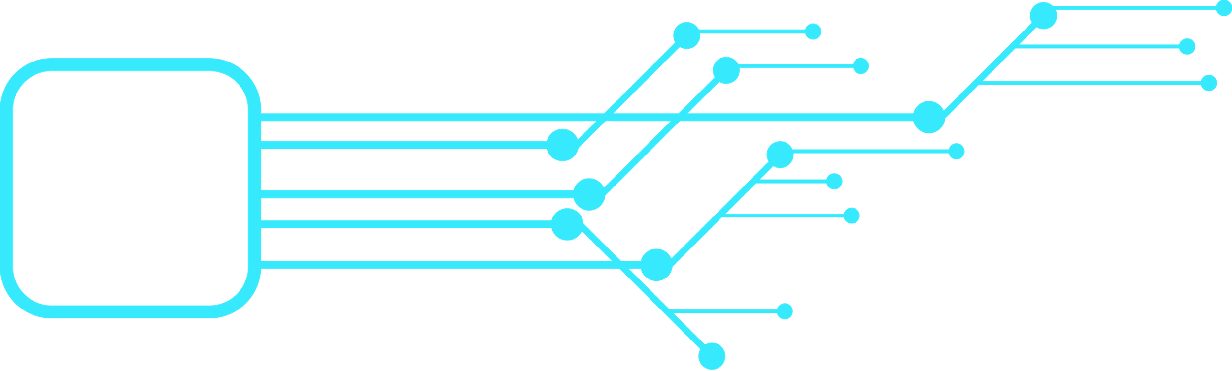
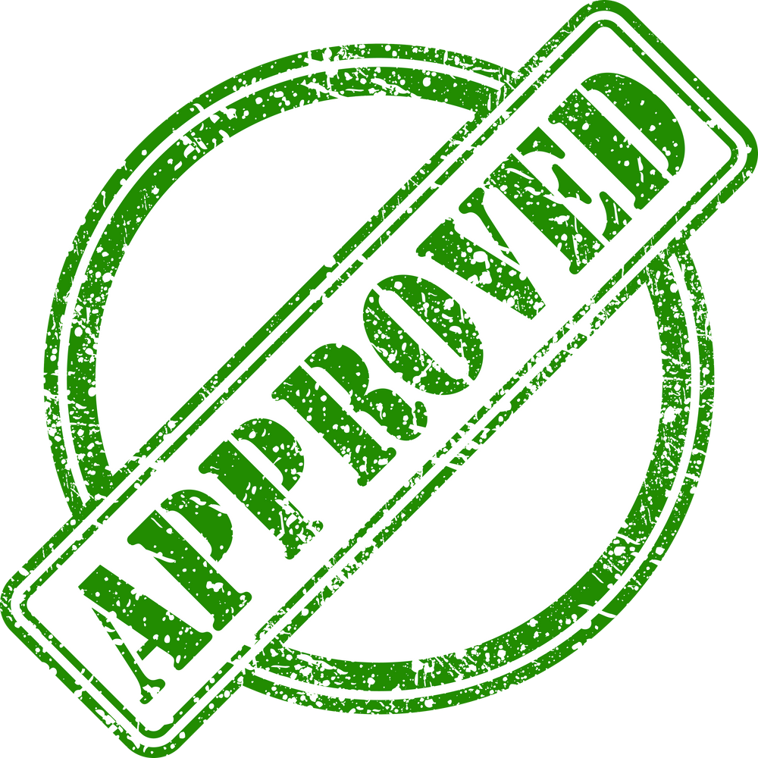
Planned Verification – Accuracy & Responsiveness
We structured a detailed verification plan to evaluate accuracy, timing, and usability across all components. Once implementation is complete, we will test:
1) Camera & Input Handling
Real-time frame capture using CameraX
Performance on mid-range Android devices
2) Pose Estimation & Joint Angles
MediaPipe landmark accuracy
Angle calculations tested with known postures
3) Feedback Responsiveness
Measure delay between motion and feedback
Target response time: < 1 second
4) Summary Reports
Accuracy of rep counting and error classification
Compare against expert evaluations
5) User Experience
Test under different lighting and positioning
Handle poor visibility, signal loss, and app flow
Notes:
Since BodyTrack is still under development, we’ve created a structured and detailed verification plan — which we will execute once the core implementation is finalized.
We know that for this system to be successful, it must be accurate, fast, and easy to use — especially since it’s meant to replace real-time human feedback.
So we’ve outlined a verification strategy that covers all major components:
1. Video Capture and Input Handling
We’ll test frame acquisition using CameraX, ensuring the app works smoothly on average Android devices — not just high-end ones.
2. Pose Estimation and Joint Angle Accuracy
Once integrated, we’ll validate MediaPipe’s output by comparing detected landmarks to real, known test postures. Then we’ll verify that our joint angle calculations match expected biomechanical values using test videos.
3. Real-Time Feedback Timing
A key metric is latency — the time from movement to correction. We plan to measure this end-to-end, and our goal is to keep feedback within 1 second, so it feels truly real-time.
4. Session Summary Validation
We’ll check that the app’s rep counter and error detection logic are reliable. That means comparing its output to that of a human trainer or an annotated video to ensure we’re classifying reps and faults correctly.
5. User Interface and Environment Tests
We will test usability under real-world conditions:
Low lighting
Unclear backgrounds
User not fully visible
Temporary network loss
We’ve also outlined how to handle these cases — for example, prompting the user to reposition themselves or warning them if the body is not fully in view.
In short: the verification hasn’t been performed yet, but a thorough test plan is ready, and it will ensure that once BodyTrack is fully implemented, we can prove it’s both effective and reliable.
Now, let’s look at the advantages BodyTrack offers — and the limitations we’re aware of.

Slide 15


Strengths and Challenges of BodyTrack
Advantages
Limitations
Real-time posture feedback using only a smartphone – no external hardware
Combines pose estimation + biomechanics + audio coaching
Modular and scalable: easy to add new exercises
Encourages safe and independent training
Lightweight, works on mid-range Android devices
Requires full-body visibility and decent lighting
Real-time feedback depends on internet connection
Feedback logic currently based on rule-based thresholds
Supports only a limited set of exercises in the current phase
Verification and model tuning are still pending
Notes:
As we move toward finalizing BodyTrack, it’s important to reflect on both what it does well, and where it still faces challenges — especially since this is an academic evaluation.
Let’s start with the strengths:
First and foremost, BodyTrack provides real-time posture correction using only a smartphone. Most other systems require wearables or smart mirrors. We don’t.
It combines multiple technologies — pose estimation, biomechanical modeling, and audio-visual feedback — in a seamless user experience.
The system is modular. We can easily add new exercises by defining new joint rules and updating the server logic — without changing the app itself.
It’s built for independent users, making safe training more accessible — especially for those who don’t have a personal trainer.
And we’ve optimized it to work smoothly on standard Android devices, not just flagship phones.
But BodyTrack isn’t perfect — at least, not yet.
Like most computer vision systems, it depends on clear visibility. If part of the user’s body is out of frame or the lighting is poor, pose estimation may struggle.
Since the pose analysis runs on a remote server, the system needs a stable internet connection for real-time feedback to work properly.
Our current error detection is based on rule-based logic — meaning we use thresholds and predefined conditions. This is effective, but not as adaptive as machine learning-based personalization, which could be a future upgrade.
Also, the system currently supports only three exercises: squats, biceps curls, and lateral shoulder raises. Expanding to a full-body workout library is possible but takes time.
Lastly, while we’ve written a full verification plan, the actual testing and tuning of thresholds, UI, and performance is still ahead of us in the final implementation phase.
Being aware of these strengths and limitations helps us improve the system — and also shows that we’re evaluating our work critically and professionally.
Let’s now wrap up with the impact BodyTrack could have, and where it can go next.

Slide 16
How BodyTrack Can Grow – and Why It Matters
Real-World Impact:
Helps users train safely and independently, with confidence
Reduces risk of injury from poor form
Supports users who can’t afford personal coaching
Encourages awareness of body movement and technique
Future Development:
Add more exercises (e.g., deadlifts, lunges, overhead presses)
Integrate adaptive feedback using machine learning
Allow offline processing for local pose estimation
Track progress over time (charts, reports)
Explore use in physical therapy and rehab settings
BodyTrack is more than a project — it’s a foundation for smarter, safer fitness.
Notes:
We built BodyTrack because we saw a clear gap:
People want to train, but not everyone can afford a coach. And even with the best intentions, many people make small, unnoticed mistakes in their form — mistakes that can lead to pain, frustration, and injury.
That’s where BodyTrack comes in.
It’s not just a workout tracker — it’s a real-time movement coach, built to help users train smarter, not harder.
We believe this project can make a real difference in how people approach fitness:
It makes professional-level feedback accessible to everyday users
It promotes injury prevention, which is often overlooked
It gives people more control over their training, especially those who work out alone or at home
But BodyTrack isn’t just about the present — it’s also about what it can become:
We’ve built it with scalability in mind.
Future development can include:
More supported exercises, covering full-body workouts
A machine learning engine that learns each user’s unique patterns and adapts the feedback over time
Offline mode using TensorFlow Lite for on-device analysis
Tracking user progress across sessions, helping them see improvement in technique
Even applications in physical therapy or injury recovery, where movement quality is critical
In short, BodyTrack is not just a prototype. It’s a vision for the future of accessible, intelligent training — where your phone helps you move better, safer, and more effectively.
Let’s close the presentation with a final thank you and invitation for questions.

Slide 17



Thank You!

